Slide 1
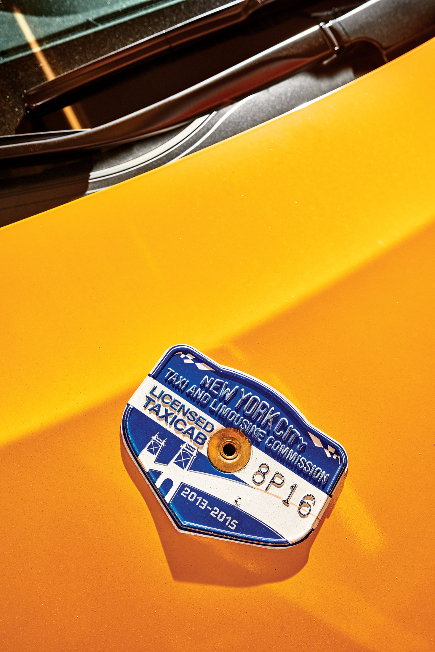
NYC Taxi Data Abhishek Das

Slide 2
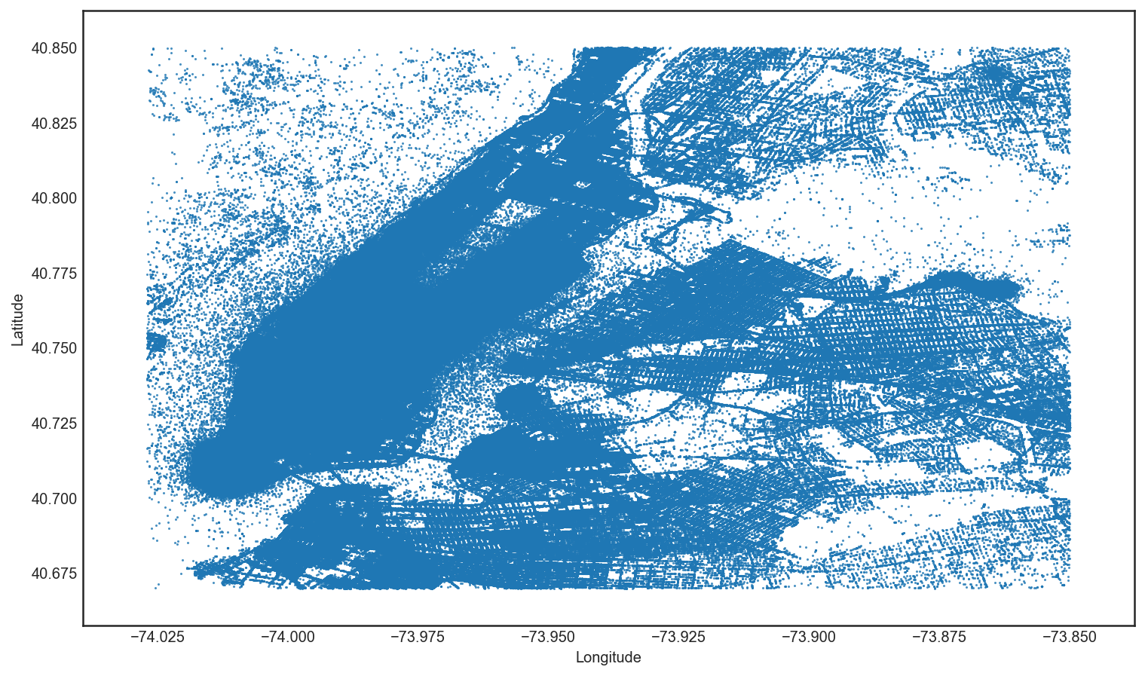
One Month
2 companies
13,276 taxis
34 million miles
$184 million in revenue

Slide 3
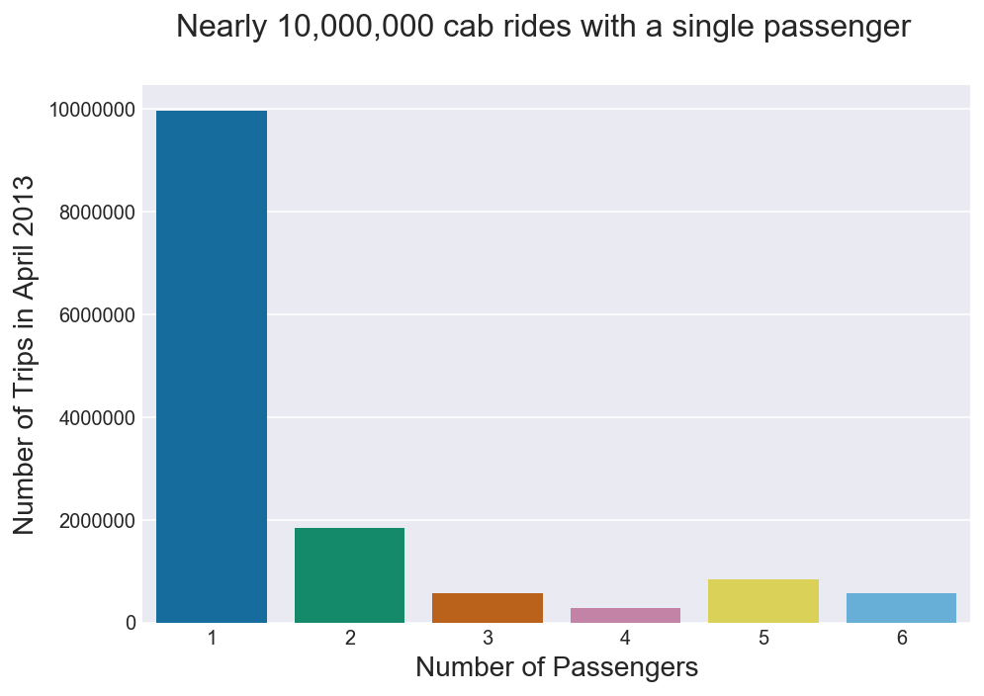
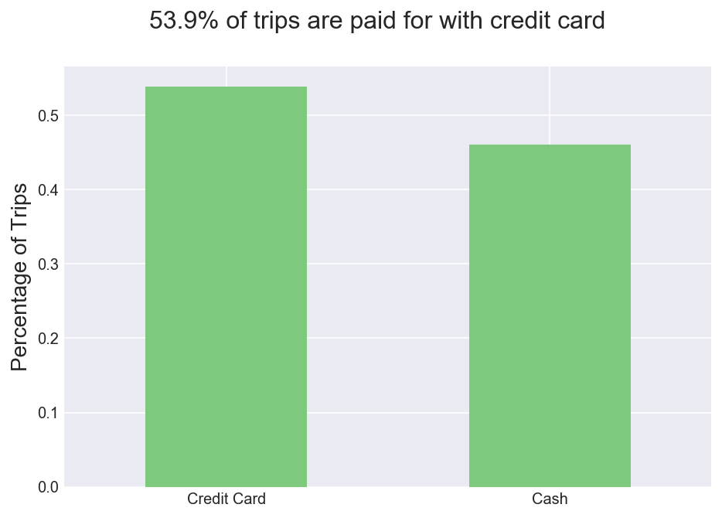
Passengers

Slide 4
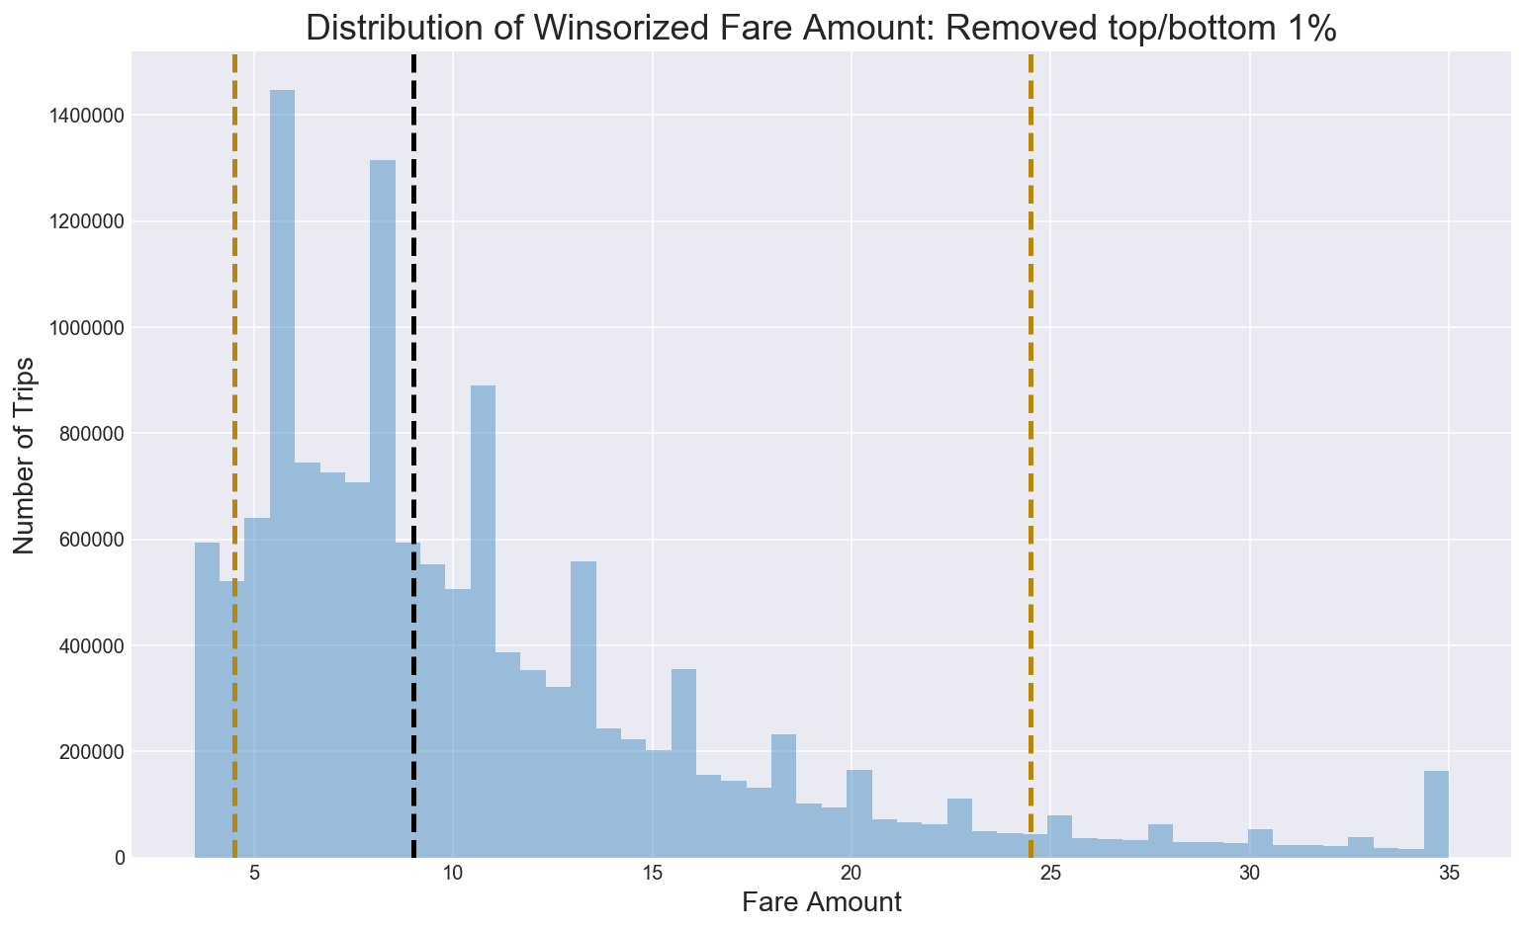
Most fares are under $35

Slide 5
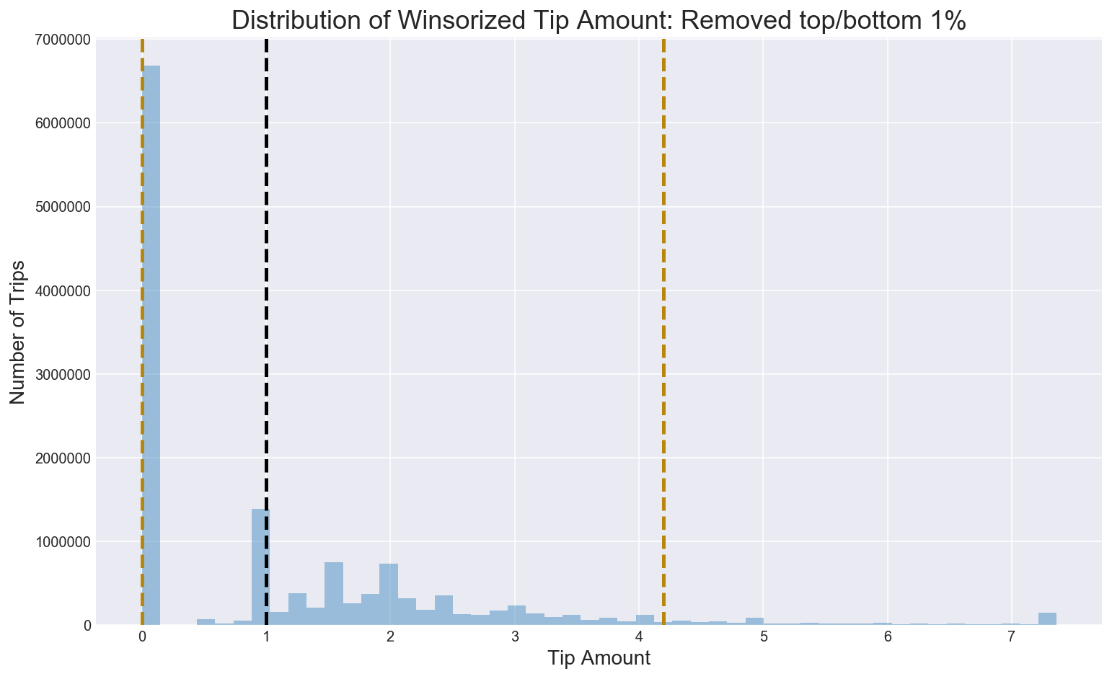
Low tips reported

Slide 6
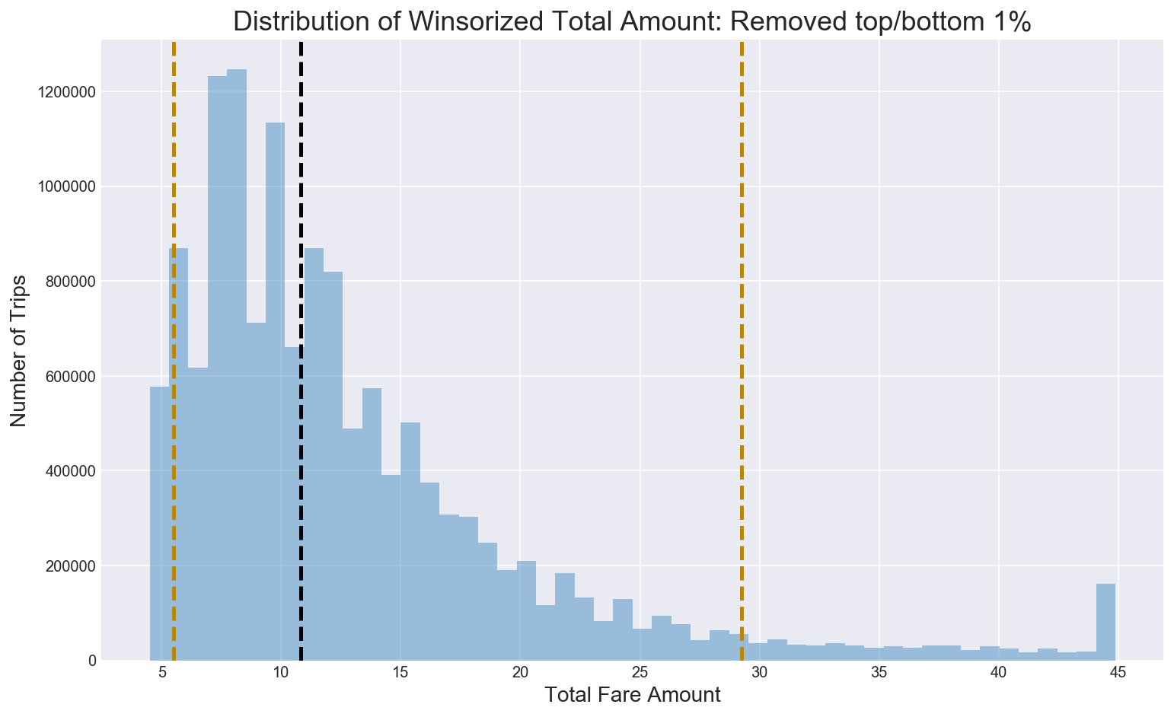
Total Amount below $45

Slide 7
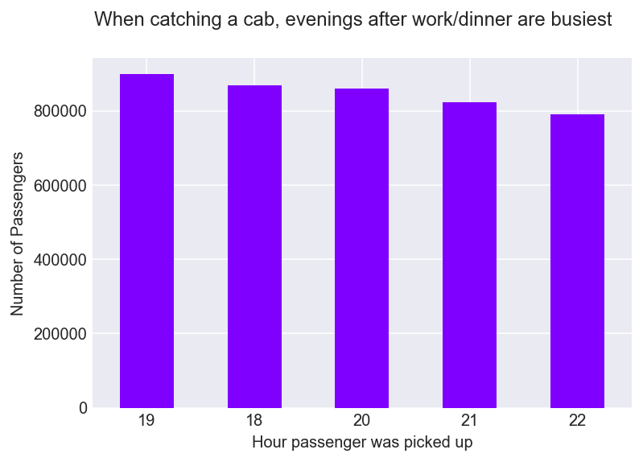
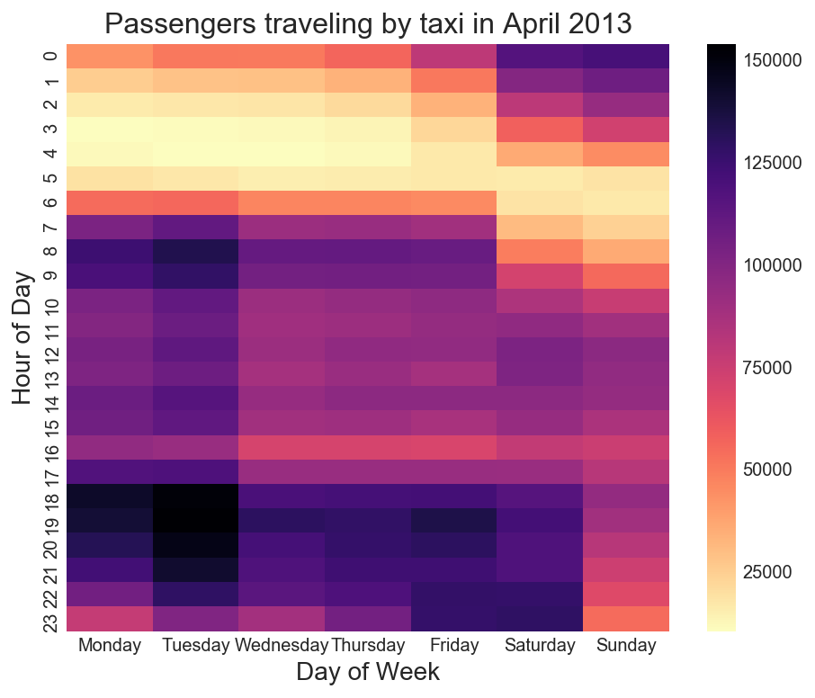
Mon, Tue & weekend evenings are busiest

Slide 8
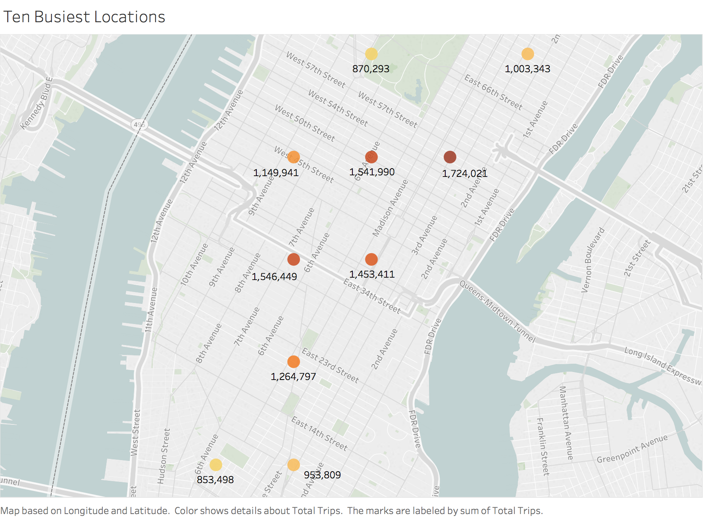
12.36m trips in Manhattan
Notes:
Most populous of New York’s five boroughs

Slide 9
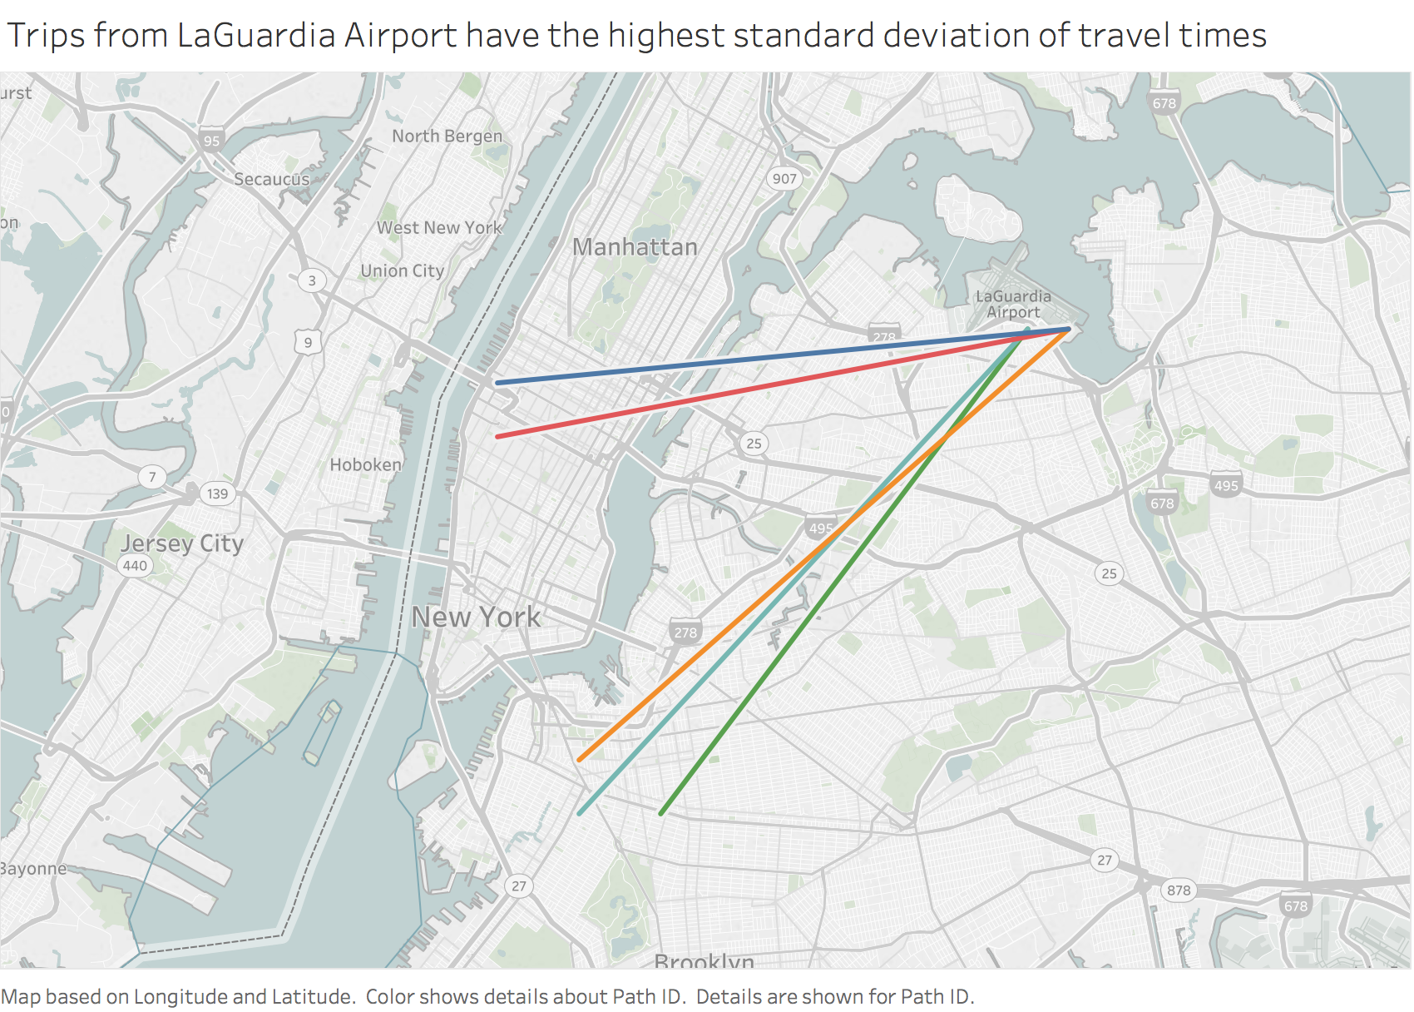
Airport travel times fluctuate

Slide 10
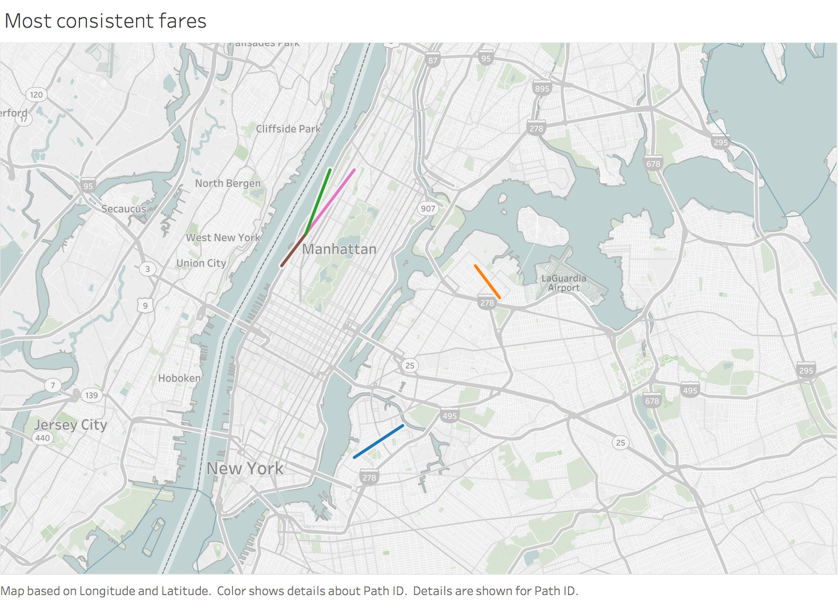
Shorter fares reliable

Slide 11
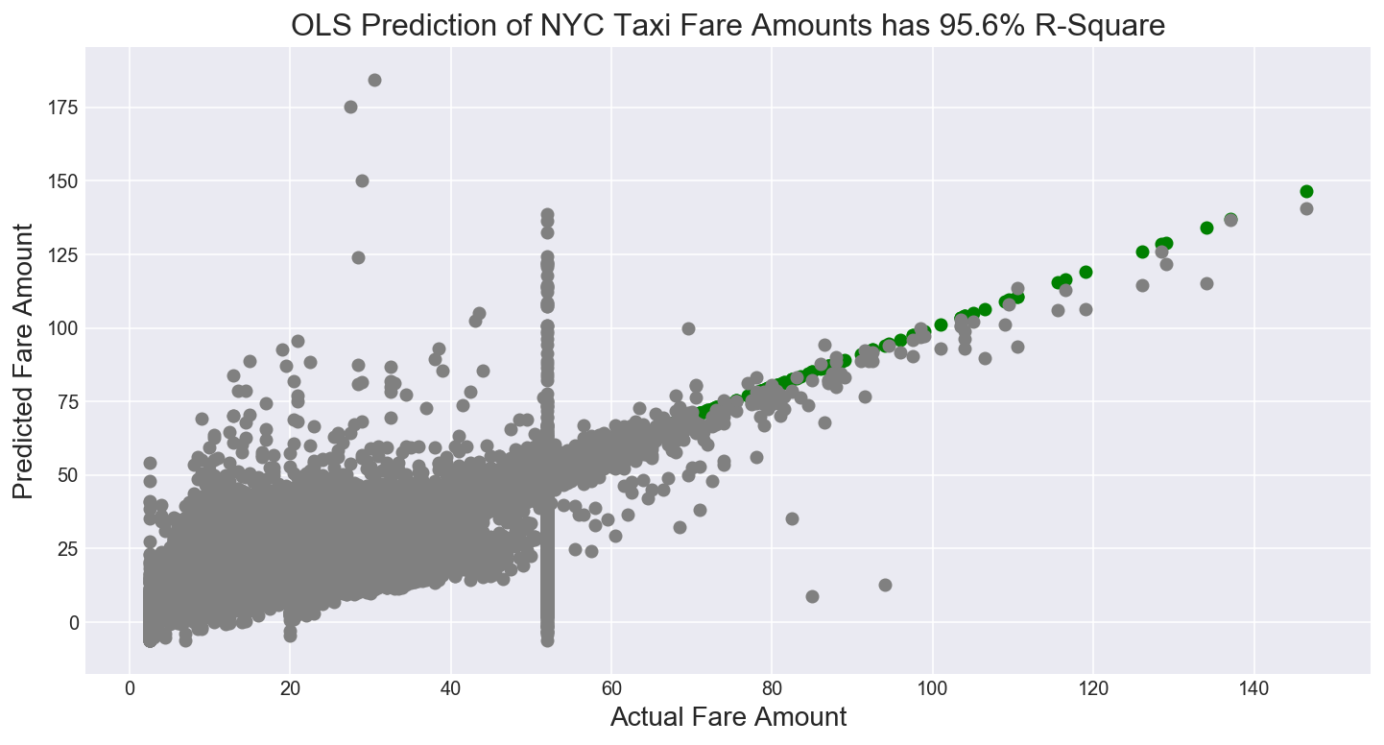
Line of best fit

